Slide 1




Fundamentals Level @ SoftUni
Welcome to Software University
SoftUni Team
Technical Trainers
Software University
http://softuni.bg

Slide 2

Welcome to SoftUni
Software University (SoftUni)
High-quality education, profession and jobs for software engineers
20+ practical courses, 20+ exams, 15+ projects → ~ 2 years
Bachelor diploma: 2 years @ SoftUni + 1 year at partner university
Study onsite and online (with onsite exams)
Jobs in Bulgaria and abroad
Free start for everyone
New Programming Basics course each month

Slide 3
SoftUni: Levels, Modules, Schedule
Programming Basics
2 months
6 credits
Programming Fundamentals
36 credits
6 months
Advanced C#
Object-Oriented Programming
High-Quality Code
Java Basics
Teamwork and Personal Skills
Web Front-End
Back-End
36 credits
36 credits
HTML + CSS + WordPress
JavaScript Basics
Advanced JavaScript
Databases
Database Applications
Web Services and Cloud
6 months
JavaScript Applications
JavaScript Frameworks
PHP Web Development
ASP.NET MVC Web Development

Slide 4
Diplomas and Certificates
Certificates
C# Developer (graduated the Programing Fundamentals module)
Front-End Developer (graduated the Front-End module)
Back-End Developer (graduated the Back-End module)
Web Developer (graduated the Front-End + Back-End modules)
Diploma from SoftUni
130 credits (from passed courses with exams)
Basics + Fundamentals + Front-End + Back-End = 114 credits

Slide 5
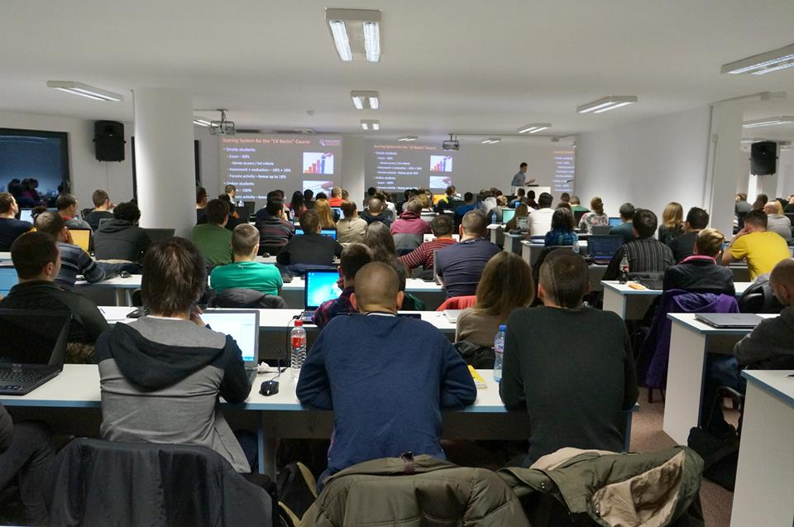
Specialized Courses
Students take credits from specialized (elective) courses
IT Basics
Digital Marketing and SEO
Data Structures
Algorithms
Linux System Administration
Many others …
The elective courses are open for everyone

Slide 6
Jobs
SoftUni helps the students to start a job in the IT industry
Contracts with 60+ companies for hiring students
Best students study free with scholarship
Top 10% of all onsite students
Students with high results choose between many employers
Students with bad results are not guaranteed to start a job
Internships in Germany and USA

Slide 7
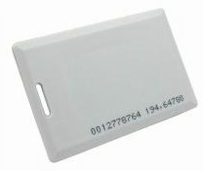
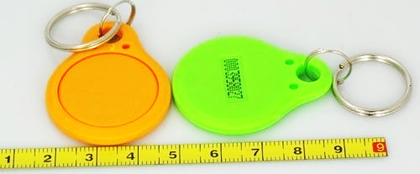

Check-In @ SoftUni
Onsite students at SoftUni should check-in when they come
We use standard 125 KHz RFID chips / cards
Check-in device (reader) is available at the SoftUni reception
Use your own chip / card or take a chip from SoftUni

Slide 8


Your RFID Chip
Students can either
Take RFID chip from SoftUni
Or use their own chip / card
Register your chip number in your SoftUni profile: https://softuni.bg/users/profile/show
Check-in at the reception every time when you come
See your last visits in your profile: https://softuni.bg/users/profile/show

Slide 9
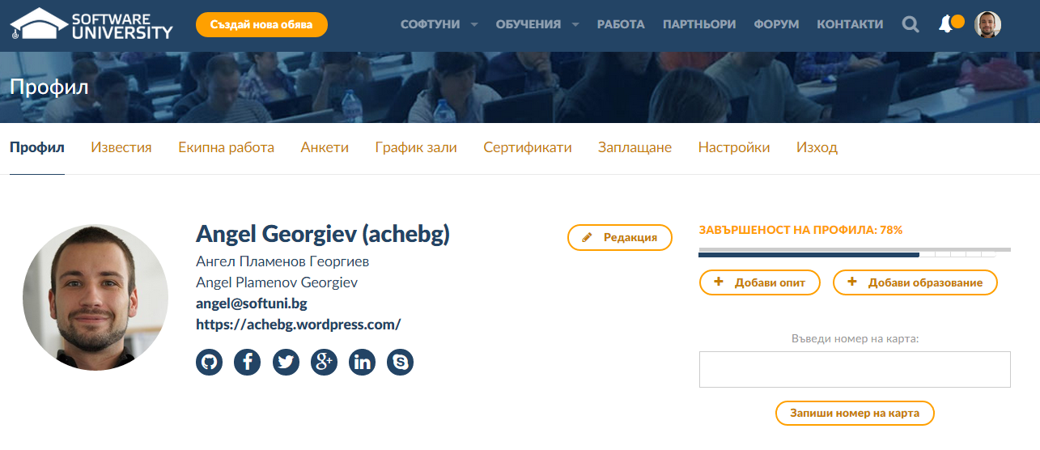
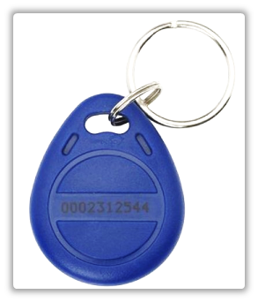
Registering Your Chip – Step 1
Enter the chip number in this box
This is your chip number

Slide 10
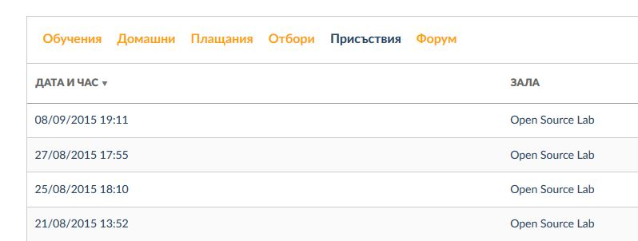
Registering Your Chip – Step 2
View your latest attendances
Go to softuni.bg/users/profile/show
or just navigate to your profile

Slide 11
Free Licenses from Our Partners
SoftUni has partnerships, to provide free educational licenses to all its students (after level "Fundamentals")
From JetBrains
ReSharper – powerful add-on for Visual Studio for C# developers
WebStorm – powerful IDE for JavaScript developers
PhpStorm – powerful IDE for PHP developers
From SuperHosting.bg
Free hosting for your site / blog

Slide 12
Free Licenses from Our Partners (2)
From Microsoft
Free access to Windows Azure cloud
DreamSpark accounts – coming soon …

Slide 13










Welcome to Fundamentals Level
https://softuni.bg/courses/programming-basics/

Slide 14
License
This course (slides, examples, demos, videos, homework, etc.) is licensed under the "Creative Commons Attribution-NonCommercial-ShareAlike 4.0 International" license
Attribution: this work may contain portions from
"Fundamentals of Computer Programming with C#" book by Svetlin Nakov & Co. under CC-BY-SA license
"C# Part I" course by Telerik Academy under CC-BY-NC-SA license

Slide 15





Free Trainings @ Software University
Software University Foundation – softuni.org
Software University – High-Quality Education, Profession and Job for Software Developers
softuni.bg
Software University @ Facebook
facebook.com/SoftwareUniversity
Software University @ YouTube
youtube.com/SoftwareUniversity
Software University Forums – forum.softuni.bg

